Slide 1
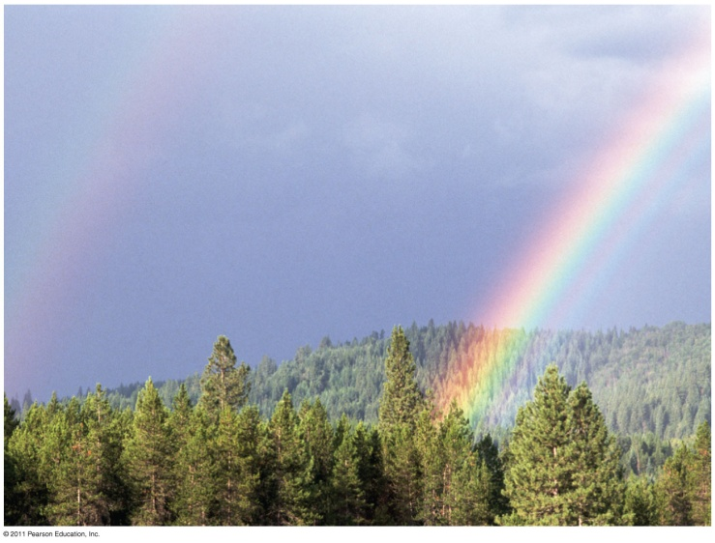
Chapter 10
Photosynthesis

Slide 2
The Process That Feeds the Biosphere
Photosynthesis is the process that converts solar energy into chemical energy
Directly or indirectly, photosynthesis nourishes almost the entire living world

Slide 3
Photosynthesis
Autotrophs sustain themselves without eating anything derived from other organisms
Autotrophs are the producers of the biosphere, producing organic molecules from CO₂ and other inorganic molecules
Almost all plants are photoautotrophs, using the energy of sunlight to make organic molecules

Slide 4
Photosynthesis
Photosynthesis occurs in plants, algae, certain other protists, and some prokaryotes
These organisms feed not only themselves but also most of the living world

Slide 5
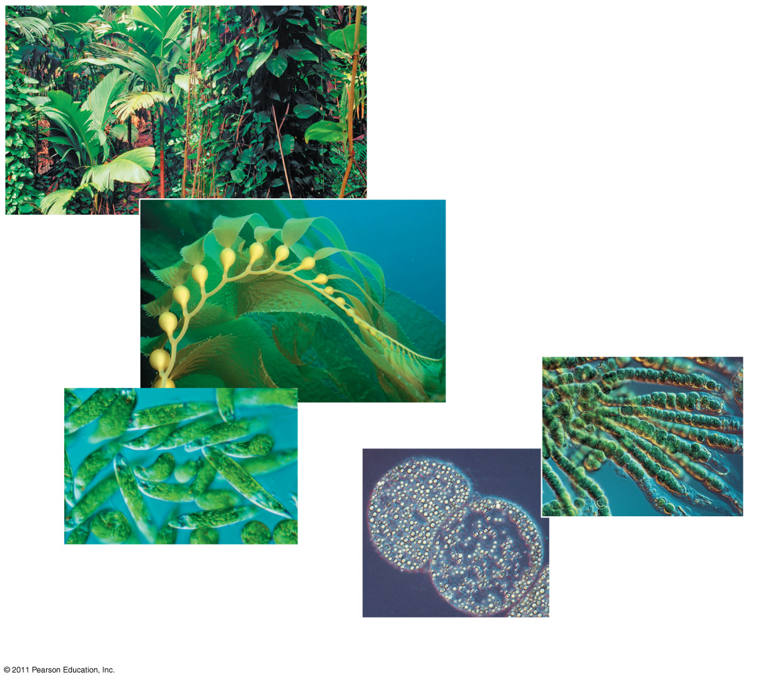
Photosynthesis
Plants
Multicellular alga
Cyanobacteria
Unicellular protists
Purple sulfur bacteria

Slide 6
Photosynthesis
Heterotrophs obtain their organic material from other organisms
Heterotrophs are the consumers of the biosphere
Almost all heterotrophs, including humans, depend on photoautotrophs for food and O₂

Slide 7
Photosynthesis
The Earth’s supply of fossil fuels was formed from the remains of organisms that died hundreds of millions of years ago
In a sense, fossil fuels represent stores of solar energy from the distant past

Slide 8
Photosynthesis converts light energy to the chemical energy of food
Chloroplasts are structurally similar to and likely evolved from photosynthetic bacteria
The structural organization of these cells allows for the chemical reactions of photosynthesis

Slide 9
Chloroplasts: The Sites of Photosynthesis in Plants
Leaves are the major locations of photosynthesis
Their green color is from chlorophyll, the green pigment within chloroplasts
Chloroplasts are found mainly in cells of the mesophyll, the interior tissue of the leaf
Each mesophyll cell contains 3o – 40 chloroplasts

Slide 10
Chloroplasts
CO₂ enters and O₂ exits the leaf through microscopic pores called stomata
The chlorophyll is in the membranes of thylakoids (connected sacs in the chloroplast); thylakoids may be stacked in columns called grana
Chloroplasts also contain, stroma, a dense interior fluid

Slide 11
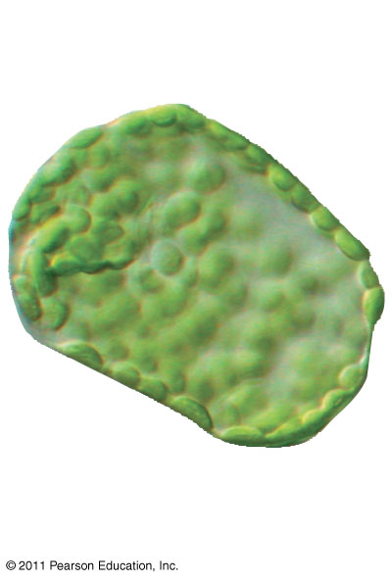
Photosynthesis
Mesophyll cell

Slide 12
Photosynthesis
Photosynthesis is a complex series of reactions that can be summarized as the following equation:
6 CO₂ + 12 H₂O + Light energy → C₆H₁₂O₆ + 6 O₂ + 6 H₂O

Slide 13
Photosynthesis
Chloroplasts split H₂O into hydrogen and oxygen, incorporating the electrons of hydrogen into sugar molecules and releasing oxygen as a by-product

Slide 14
Photosynthesis
Photosynthesis reverses the direction of electron flow compared to respiration
Photosynthesis is a redox process in which H₂O is oxidized and CO₂ is reduced
Photosynthesis is an endergonic process; the energy boost is provided by light

Slide 15
Photosynthesis
becomes reduced
Energy + 6 CO₂ + 6 H₂O
C₆ H₁₂ O₆ + 6 O₂
becomes oxidized

Slide 16
The Two Stages of Photosynthesis: A
Photosynthesis consists of the light reactions (the photo part) and Calvin cycle (the synthesis part)
The light reactions (in the thylakoids)
Split H₂O
Release O₂
Reduce NADP⁺ to NADPH
Generate ATP from ADP by photophosphorylation

Slide 17
Photosynthesis
The Calvin cycle (in the stroma) forms sugar from CO₂, using ATP and NADPH
The Calvin cycle begins with carbon fixation, incorporating CO₂ into organic molecules

Slide 18
The light reactions convert solar energy to the chemical energy of ATP and NADPH
Chloroplasts are solar-powered chemical factories
Their thylakoids transform light energy into the chemical energy of ATP and NADPH

Slide 19
Photosynthetic Pigments: The Light Receptors
Pigments are substances that absorb visible light
Different pigments absorb different wavelengths
wavelenghts that are not absorbed are reflected or transmitted
Leaves appear green because chlorophyll reflects and transmits green light

Slide 20
Photosynthetic Pigments
A spectrophotometer measures a pigment’s ability to absorb various wavelengths
This machine sends light through pigments and measures the fraction of light transmitted at each wavelength

Slide 21
Photosynthetic Pigments
An absorption spectrum is a graph plotting a pigment’s light absorption versus wavelength
The absorption spectrum of chlorophyll a suggests that violet-blue and red light work best for photosynthesis

Slide 22
Photosynthetic Pigments
The action spectrum of photosynthesis was first demonstrated in 18 8 3 by Theodor Engelman
In his experiment, he exposed different segments of a filamentous alga to different wavelengths
Areas receiving wavelengths favorable to photosynthesis produced excess O₂
He used the growth of aerobic bacteria clustered along the alga as a measure of O₂ production

Slide 23
Photosynthetic Pigments
Chlorophyll a is the main photosynthetic pigment
Accessory pigments, such as chlorophyll b, broaden the spectrum used for photosynthesis

Slide 24
Excitation of Chlorophyll by Light
W hen a pigment absorbs light, it goes from a ground state to an excited state, which is unstable
W hen excited electrons fall back to the ground state, photons are given off, an afterglow called fluorescence
If illuminated, an isolated solution of chlorophyll will fluoresce, giving off light and heat

Slide 25
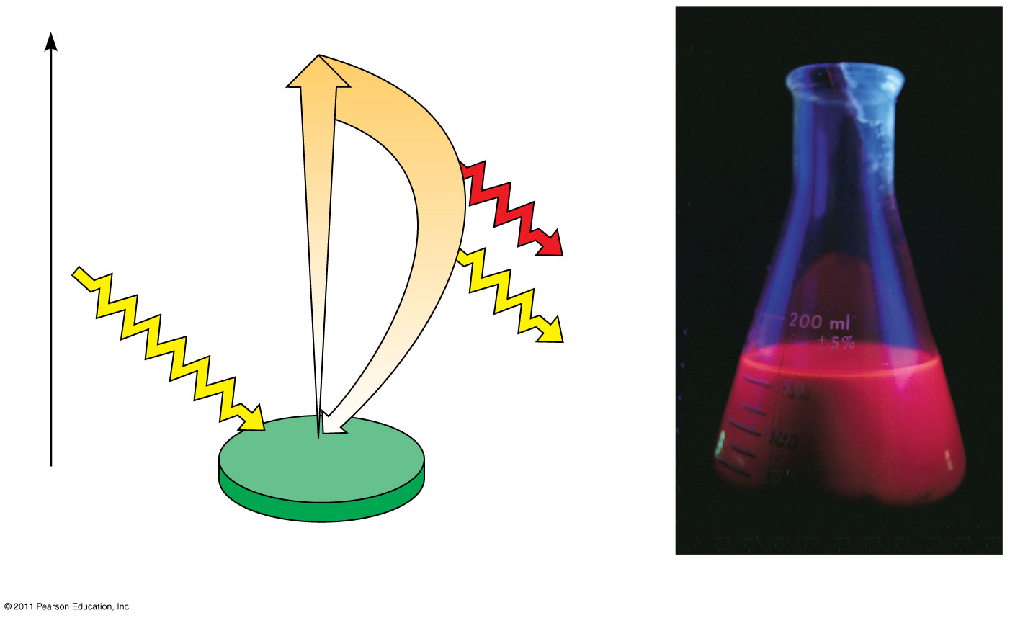
Excitation of Chlorophyll by Light
e⁻
Ex cited state
Heat
Energy of electron
Photon (fluorescence
Photon
Ground state
Chlorophyll molecule
Ex citation f isolated chlorophyll molecule

Slide 26
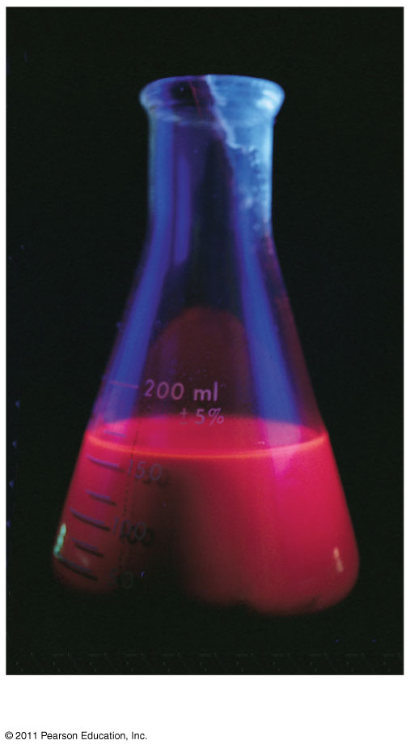
Photosynthesis
Fluorescence

Slide 27
Photosynthesis
A photosystem consists of a reaction-center complex a type of protein complex) surrounded by light-harvesting complexes
The light-harvesting complexes (pigment molecules bound to proteins) transfer the energy of photons to the reaction center

Slide 28
Photosynthesis
A primary electron acceptor in the reaction center accepts excited electrons and is reduced as a result
Solar powered transfer of an electron from a chlorophyll a molecule to the primary electron acceptor is the first step of the light reactions

Slide 29
Photosynthesis
There are two types of photosystems in the thylakoid membrane
Photosystem II ( PS II) functions first (the numbers reflect order of discovery) and is best at absorbing a wavelength of 680nm
The reaction-center chlorophyll a of PS II is called PS 680

Slide 30
Photosynthesis
Photosystem I ( PS I ) is best at absorbing a wavelength of 7 00 nm
The reaction-center chlorophyll a of PS I is called P 700

Slide 31
Linear Electron Flow
During the light reactions, there are two possible routes for electron flow: cyclic and linear
L inear electron flow, the primary pathway, involves both photosystems and produces ATP and NADPH using light energy

Slide 32
Linear Electron Flow
A photon hits a pigment and its energy is passed among pigment molecules until it excites P 680
An excited electron from P 680 is transferred to the primary electron acceptor (we now call it P 680 +

Slide 33
Linear Electron Flow
P 680 ⁺ is a very strong oxidizing agent
H₂O is split by enzymes, and the electrons are transferred from the H atoms to P680 ⁺ thus reducing it to P 680
O₂ is released as a by-product of this reaction

Slide 34
Linear Electron Flow
Each electron “falls” down an electron transport chain from the primary electron acceptor of PS II to PS I
Energy released by the fall drives the creation of a proton gradient across the thylakoid membrane
Diffusion of H⁺ (protons) across the membrane drives ATP synthesis

Slide 35
A Comparison of Chemiosmosis in Chloroplasts and Mitochondria
Chloroplasts and mitochondria generate ATP by chemiosmosis, but use different sources of energy
Mitochondria transfer chemical energy from food to ATP; chloroplasts transform light energy into the chemical energy of ATP
Spatial organization of chemiosmosis differs between chloroplasts and mitochondria but also shows similarities

Slide 36
A Comparison of Chemiosmosis in Chloroplasts and Mitochondria
In mitochondria, protons are pumped to the intermembrane space and drive ATP synthesis as they diffuse back into the mitochondrial matrix
In chloroplasts, protons are pumped into the thylakoid space and drive ATP synthesis as they diffuse back into the stroma

Slide 37
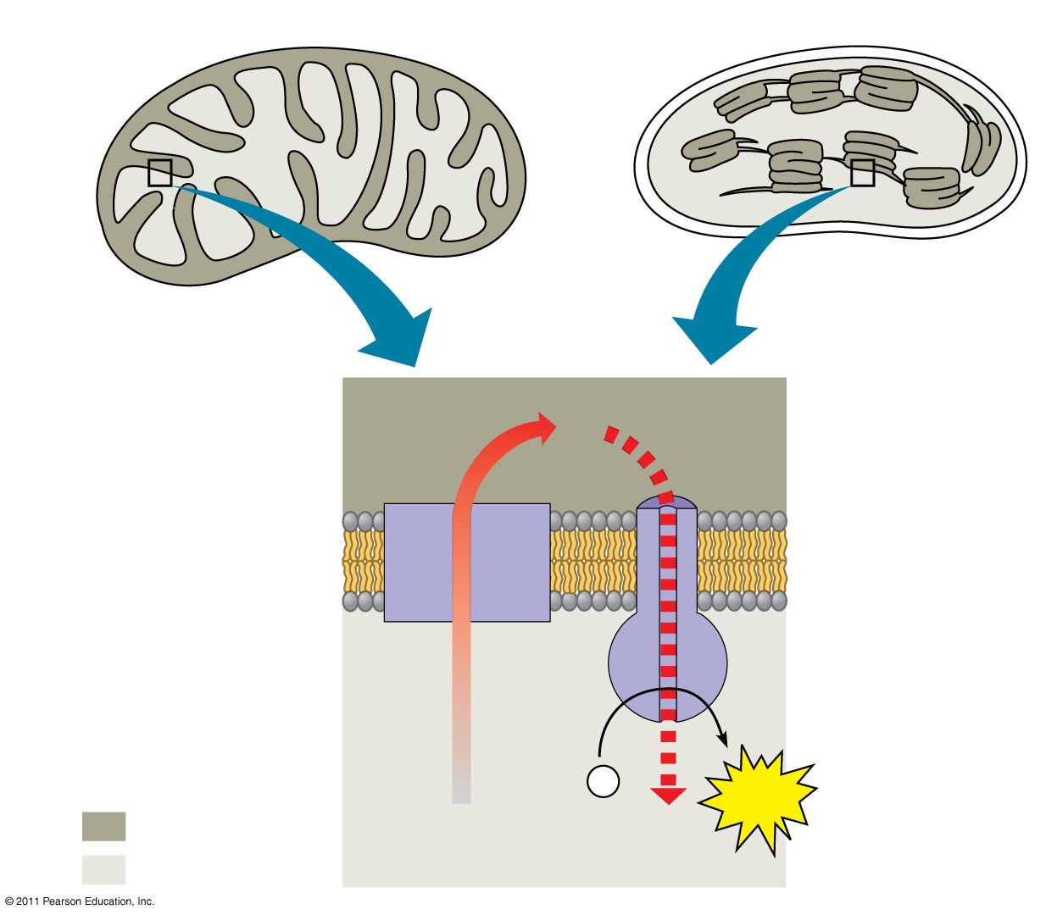
A Comparison of Chemiosmosis in Chloroplasts and Mitochondria
Mitochondrion
Chloroplast
Intermembrane space
H⁺
ThylaKoid space
Diffusion
Inner membrane
Electron transport chain
Thylakoid membrane
AT T P synthase
Matrix
ADP + P _{i}
A TP
stroma
Higher [H⁺ ]
Lower [H⁺ ]

Slide 38
A Comparison of Chemiosmosis in Chloroplasts and Mitochondria
ATP and NADPH are produced on the side facing the stroma, where the Calvin cycle takes place
I n summary, light reactions generate ATP and increase the potential energy of electrons by moving them from H₂O to N ADPH

Slide 39
The Importance of Photosynthesis
The energy entering chloroplasts as sunlight gets stored as chemical energy in organic compounds
Sugar made in the chloroplasts supplies chemical energy and carbon skeletons to synthesize the organic molecules of cells
Plants store excess sugar as starch in structures such as roots, tubers, seeds, and fruits
In addition to food production, photosynthesis produces the O₂ in our atmosphere

Slide 40
The E nd

